Slide 1
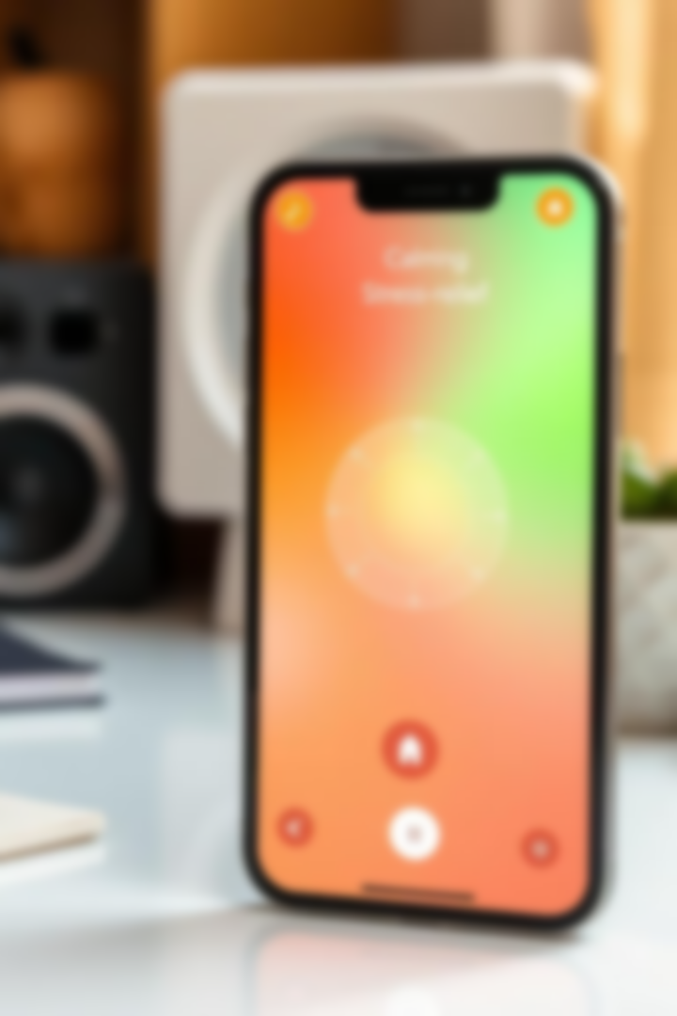
ZenQuest
Interactive Stress-Reduction Game
Team BO2 - TFC
Team Members:
Aasir Farrukh (21I-0375)
Hamza Saeed (21I-0671)
Qazi Mohib-Un-Nabi (21I-2532)

Slide 2
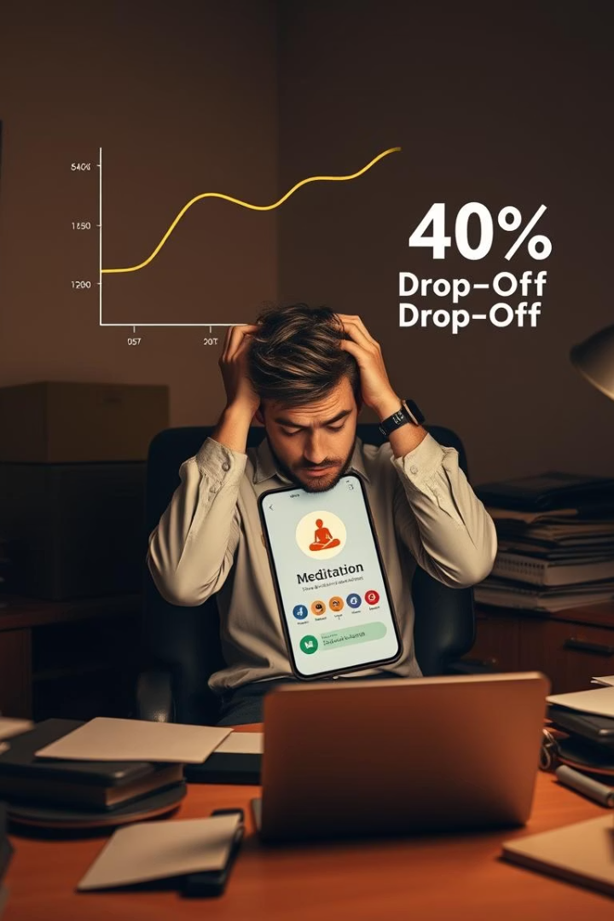
Why ZenQuest?
User Pain
40% abandonment in 2 weeks for Calm/Headspace apps indicates usability issues.
User Needs
Ultra-short relief (1–3 min) during code crunch
Interactive, game-based exercises instead of passive meditation
Immediate feedback and progress tracking
Discreet, context-aware use in classrooms and labs

Slide 3
ZenQuest at a Glance
Core Features
Unique Elements
Mini-games
60-second emergency "Calm Button"
Guided breathing exercises
Discreet mode for classroom use
Puzzles
Context-specific flows tailored to stress situations
Progress tracker
One-tap access

Slide 4
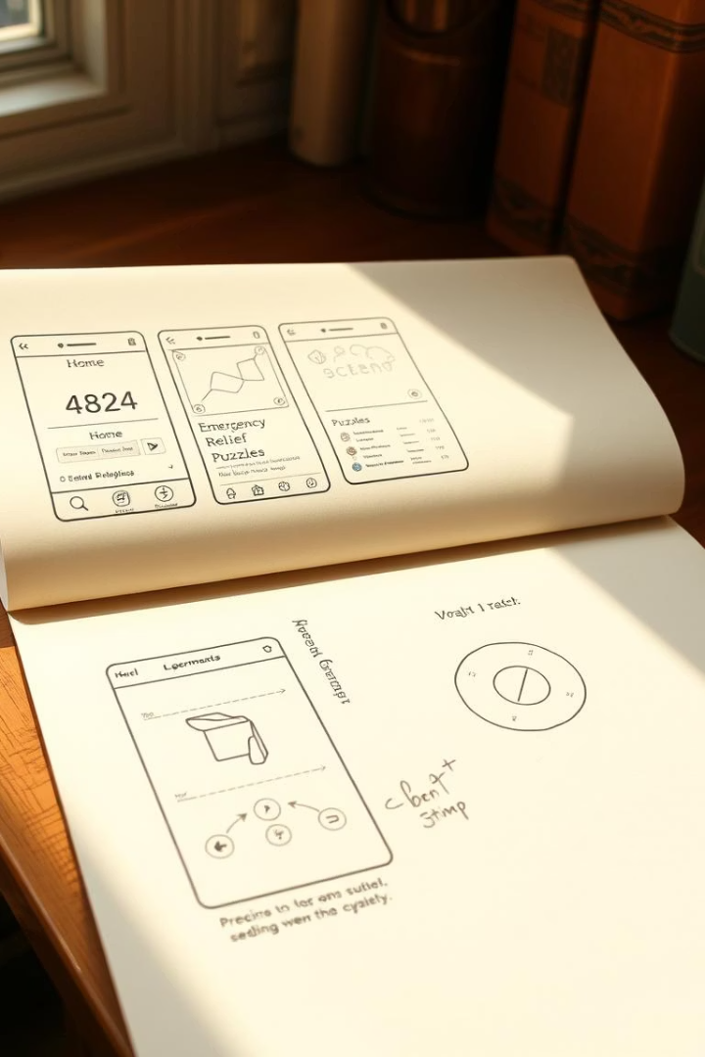
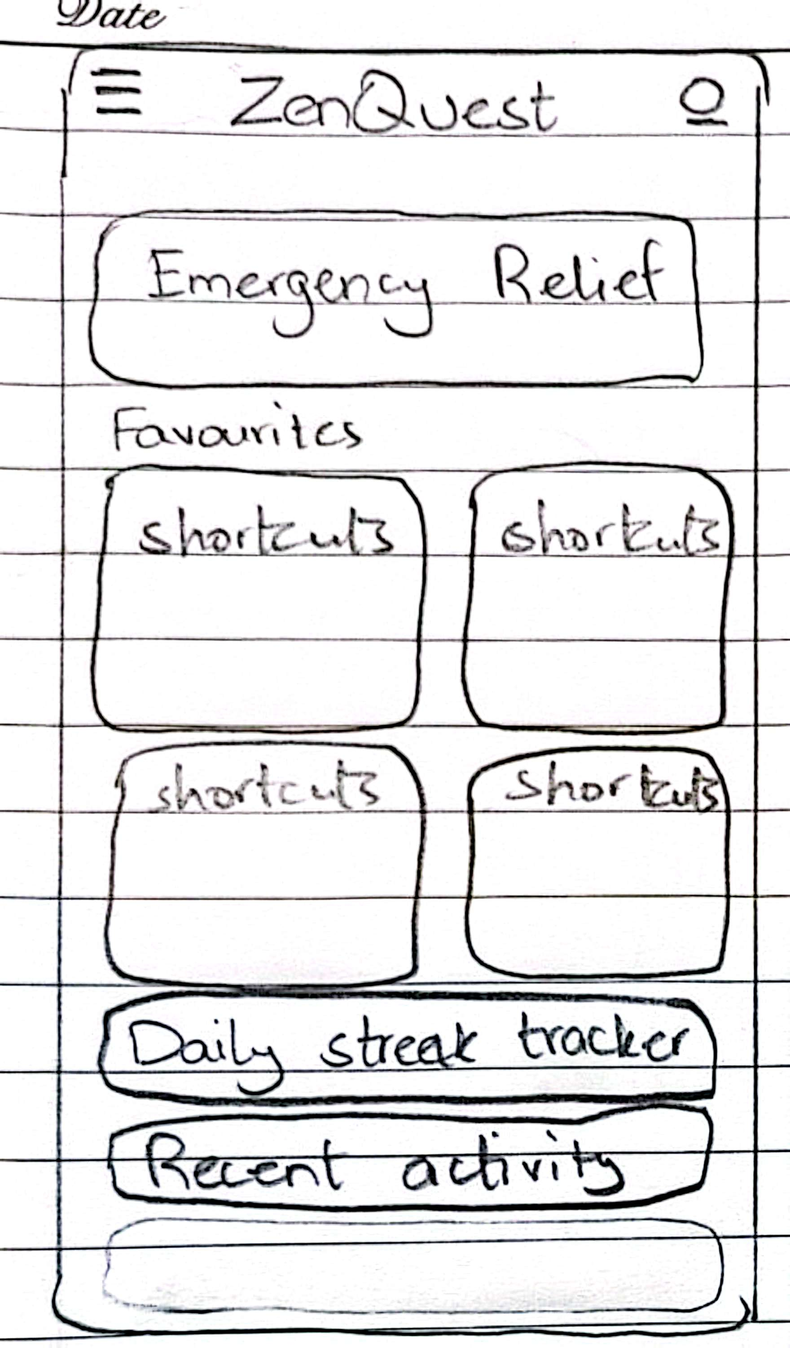
From Paper to Prototype (Lo-Fi)
1
Key Wireframes
2
User Testing
Home, Emergency Relief, Coding game, Presentation, Study, Progress Tracker, Settings
SUS 78.3; navigation, label clarity, and tracker discovery issues identified
3
Takeaways
Persistent nav bar, explicit inhale/exhale labels, dashboard preview added

Slide 5
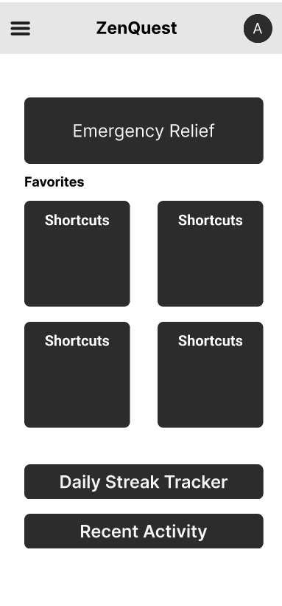



Refining with Feedback (Med-Fi)
Persistent Top Navigation
Time Badges
Dashboard Improvements
Activity cards display session lengths for planning
Emergency tab highlighted in red for quick access
Streaks and trends to motivate continued engagement
All enhancements followed heuristic evaluation and Norman’s principles validation.

Slide 6

Bringing It to Life (Hi-Fi)
Platform & Features
Early Results
React Native implementation with haptics and animations
60% retention (vs. 40%), 2-minute avg session, 85% satisfaction
60-second Code Block Breather mini-game
30-second Presentation Booster with affirmations
Animated Achievement Tree for motivation

Slide 7
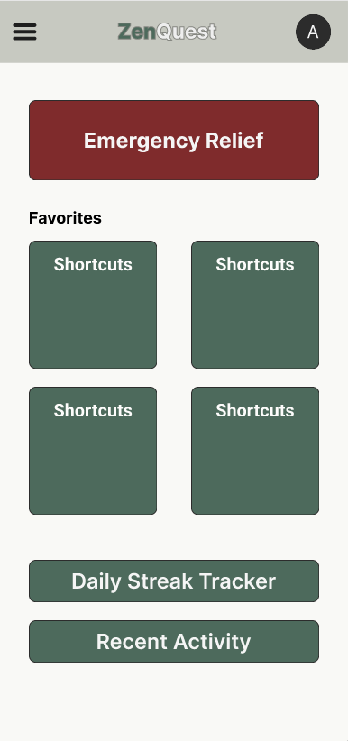
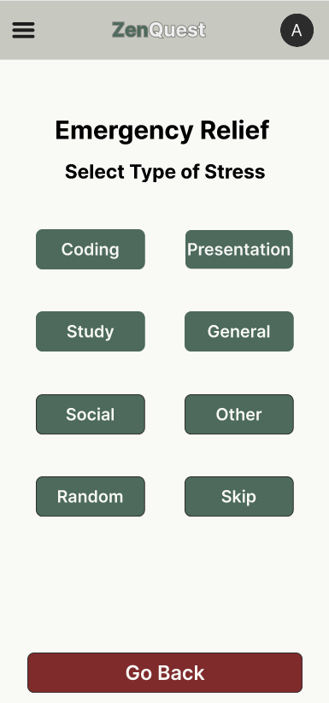
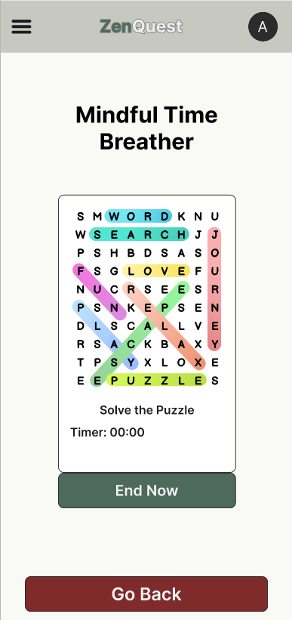

Slide 8

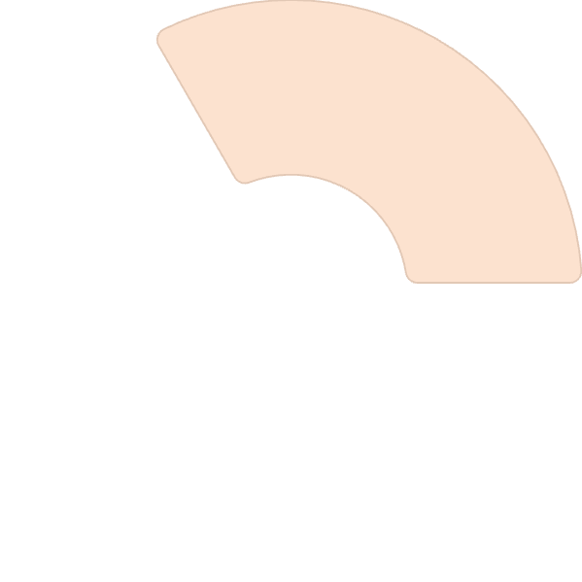




Principles & Heuristics Applied
Norman's Heuristics
Visibility: Persistent nav bar
Gestalt Principles
Feedback: Progress bars
Proximity: Group exercises logically
Constraints: Choice limits
Mapping: Icons linked to stressors
Similarity: Color coding for stressor types
Common Regions: Visual containment of features
Fixes
Clear exit buttons
Improved onboarding flow
Better labels

Slide 9
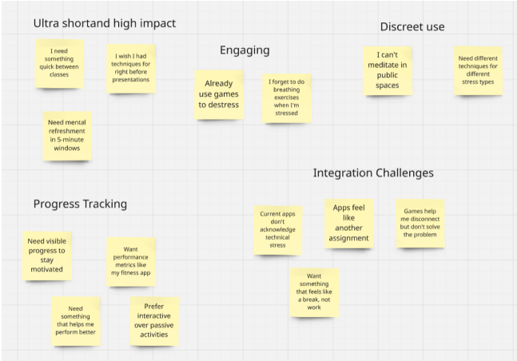
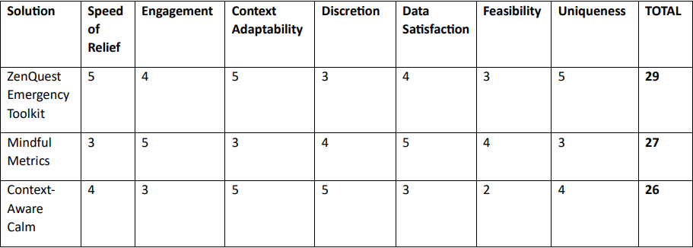
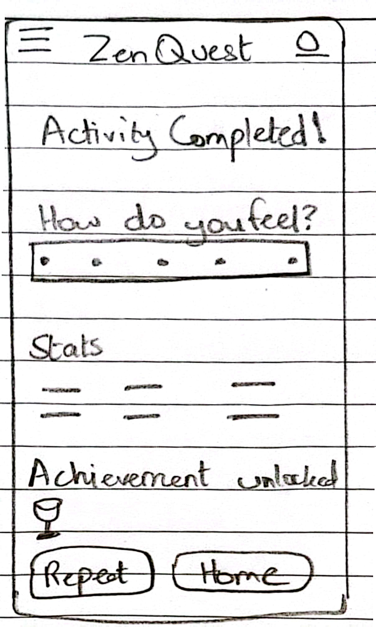
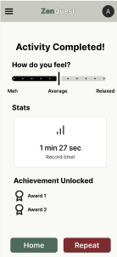
Iterative Journey
M1
1
Ideation & challenge selection
2
M2-3
Needs finding, personas, journey maps
M4
3
Design sprint & solution sketches
4
M5
Lo-fi prototyping & test
M6
5
Med-fi refinement to Hi-fi results

Slide 10


A Day with ZenQuest
Debugging Crisis
Tap Emergency for calm.
60-second Code Breather clears your mind.
Return to coding refreshed and focused.
Pre-Presentation Jitters
Activate discreet mode for privacy.
30-second Breathing Booster boosts confidence.
Step into your presentation ready to succeed.

Slide 11
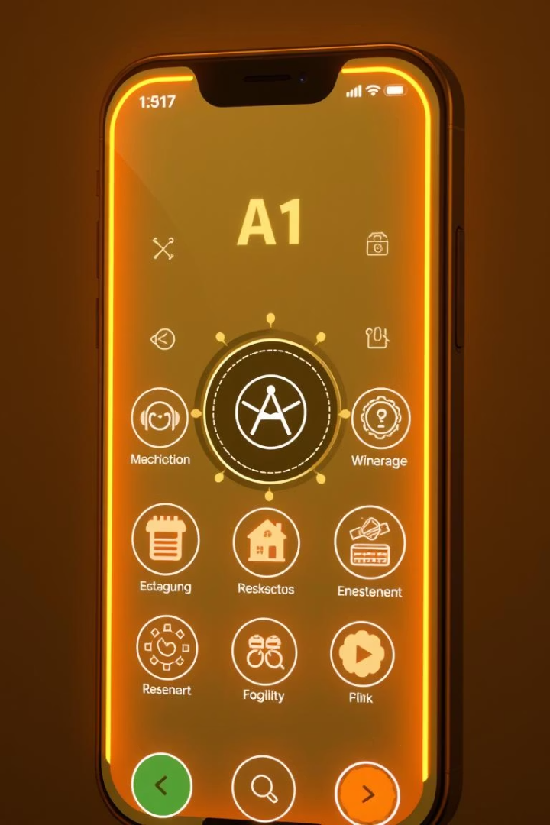



What’s Ahead
Wider Testing
Expand to other disciplines and real-world contexts
Feature Roadmap
AI context sensing, wearable integration, custom session times
Goal
Launch production-ready mobile app for stress relief

Slide 12
Thank You
We appreciate your time and interest in ZenQuest.
Looking forward to your feedback.
Figma Link

